Slide 1
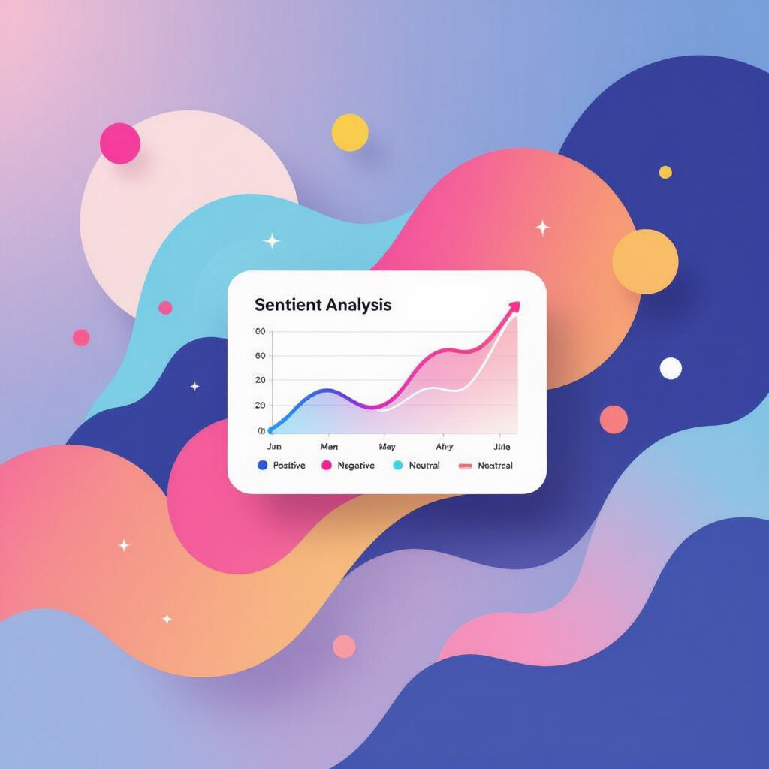
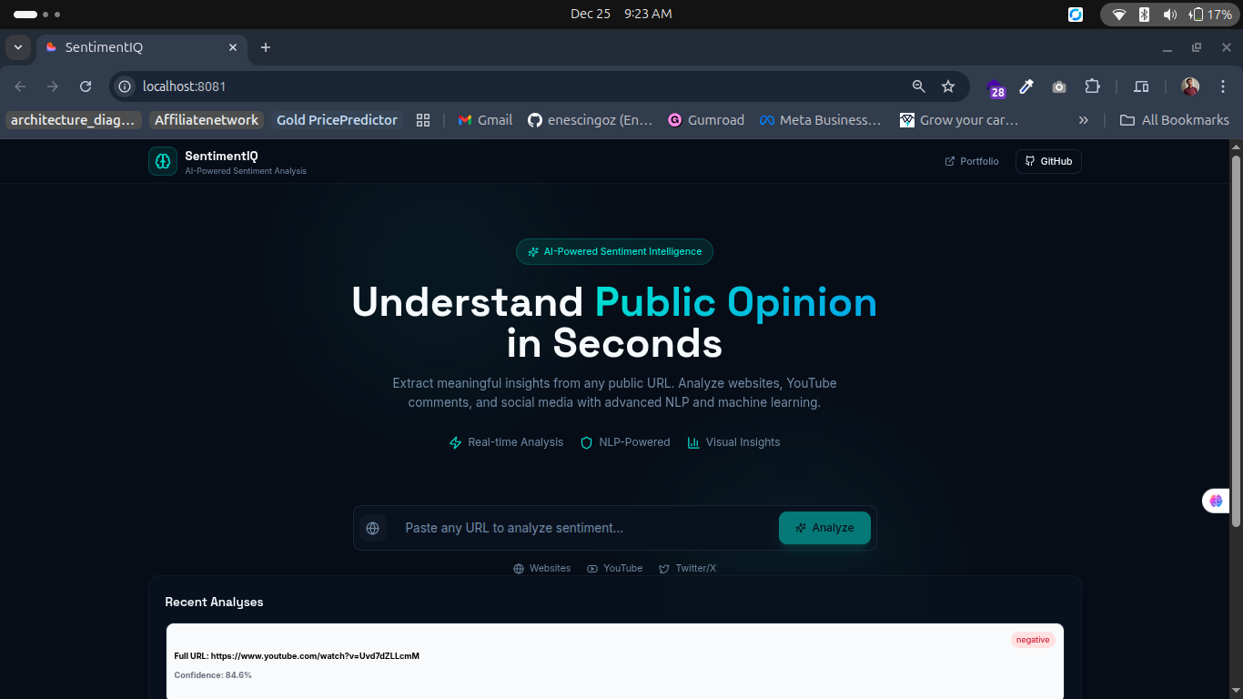
Sentiment Analysis from Any URL
This presentation introduces SentimentIQ, an AI-powered sentiment intelligence platform. The focus is on how it utilizes advanced technologies to analyze sentiment from various online sources, providing valuable insights.

Slide 2
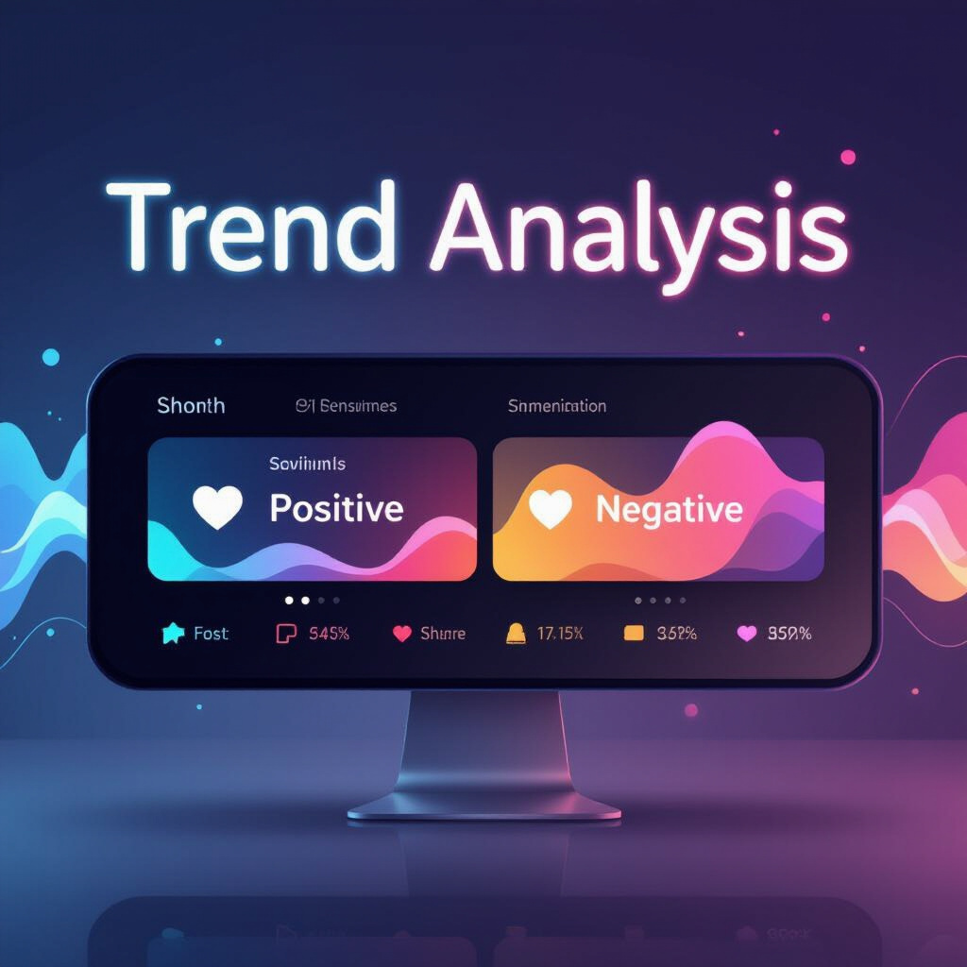
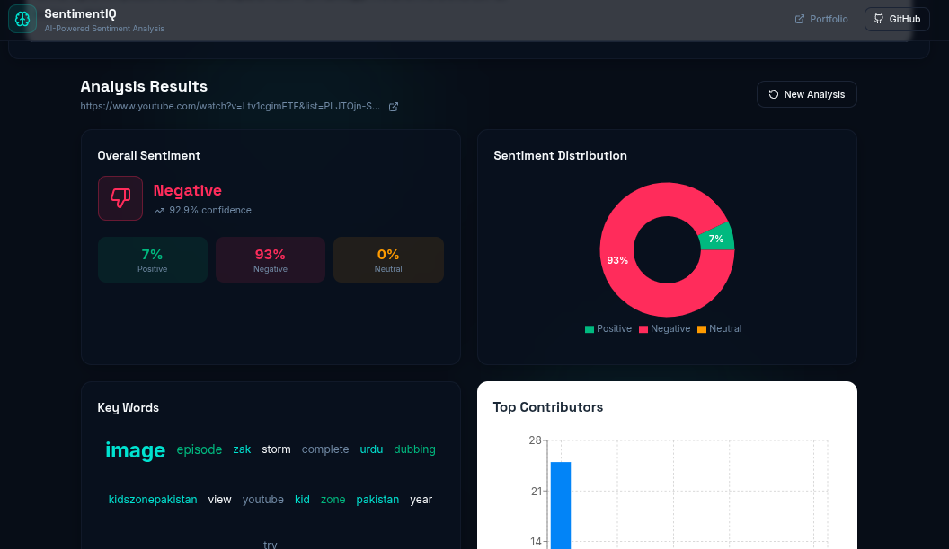
Introduction to SentimentIQ
SentimentIQ is designed to harness the power of AI for sentiment analysis. In today's data-driven world, understanding public sentiment is crucial for businesses, educators, and researchers. This platform enables users to extract and analyze sentiment from diverse online content efficiently.

Slide 3
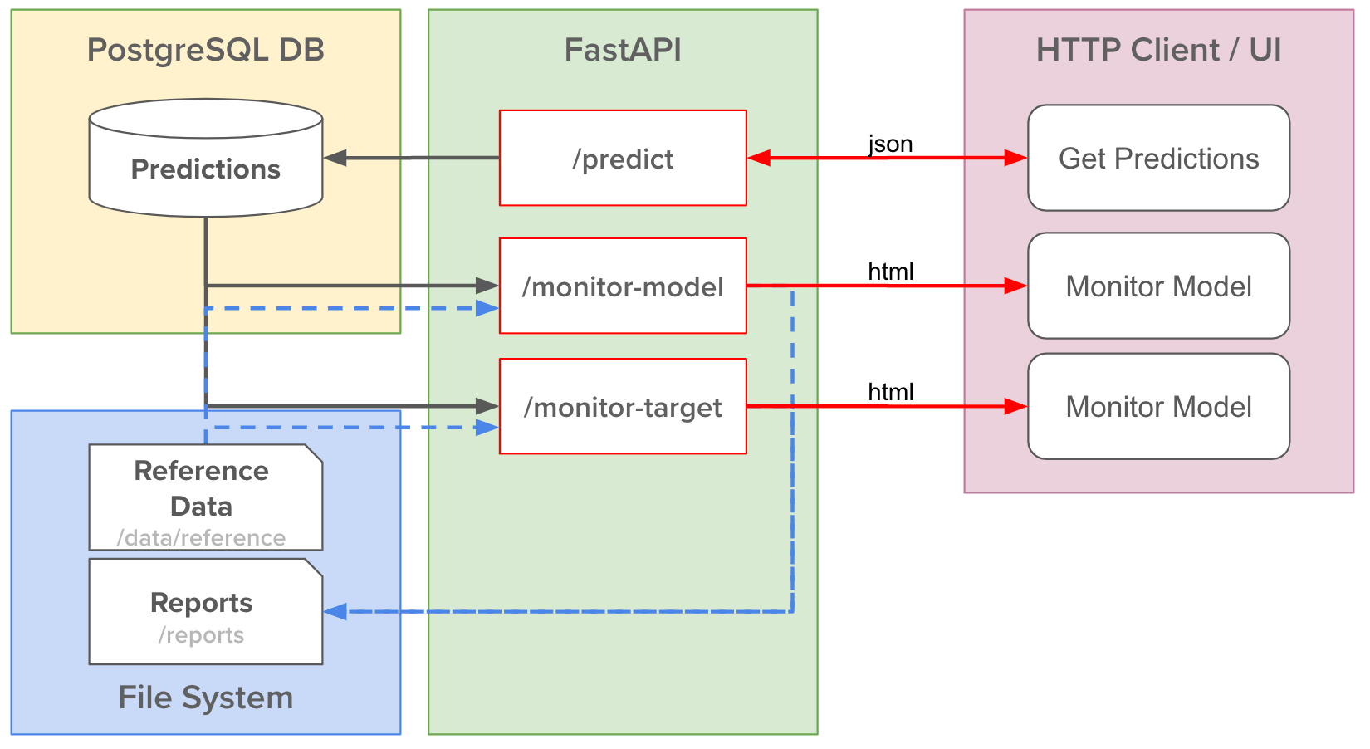
Backend Architecture Overview
The backend of SentimentIQ is built using Python FastAPI, which facilitates rapid development and efficient data processing. This architecture is responsible f- or:
Handling requests and responses.
Processing and analyzing incoming data.
Ensuring scalability and performance.

Slide 4
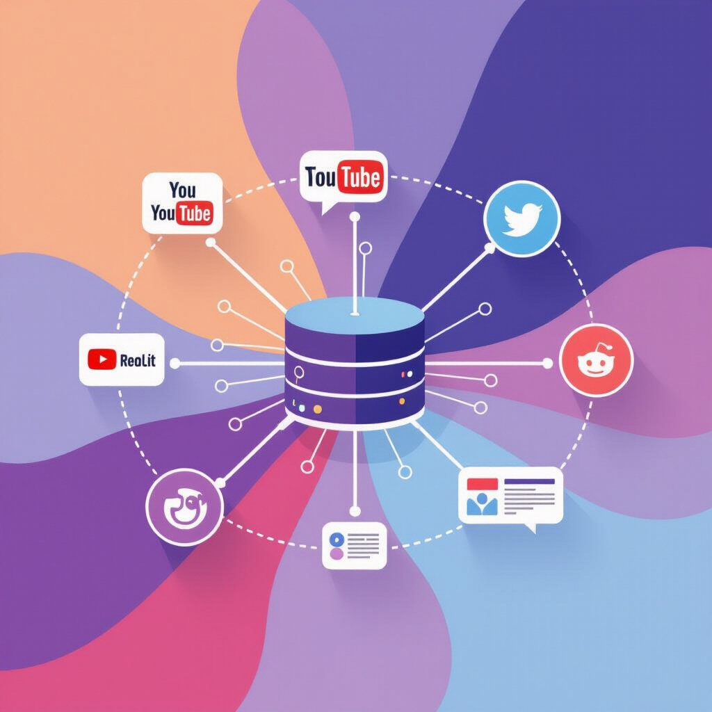
Content Extraction with Jina Reader API
The Jina Reader API plays a vital role in extracting clean content from various sources, includi- ng:
YouTube: Titles, descriptions, and user comments.
Twitter/X: Tweets and user interactions.
Reddit: Posts and comments.
Websites: Articles and blog posts.

Slide 5
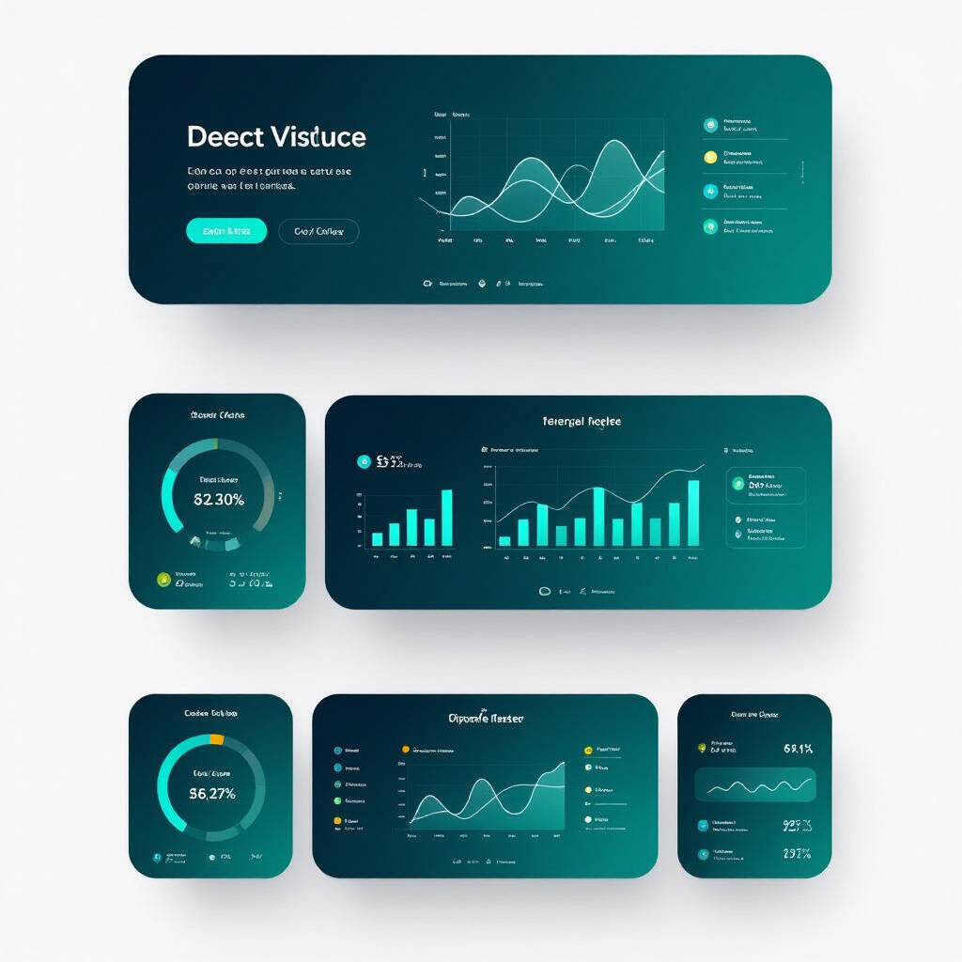
Frontend Architecture Overview
The frontend of SentimentIQ is developed using React, providing a dynamic user interface. Key roles inclu- de:
Facilitating user interaction.
Visualizing data effectively.
Ensuring a responsive design for various devices.

Slide 6
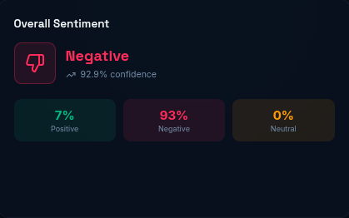
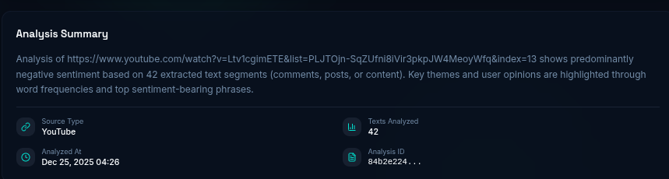
Key Features: URL Input and Live Sentiment Analysis
SentimentIQ allows users to input URLs for analysis, enabling:
Live sentiment analysis: Instant feedback on sentiment from the provided content.
Enhanced user engagement through interactive features.

Slide 7
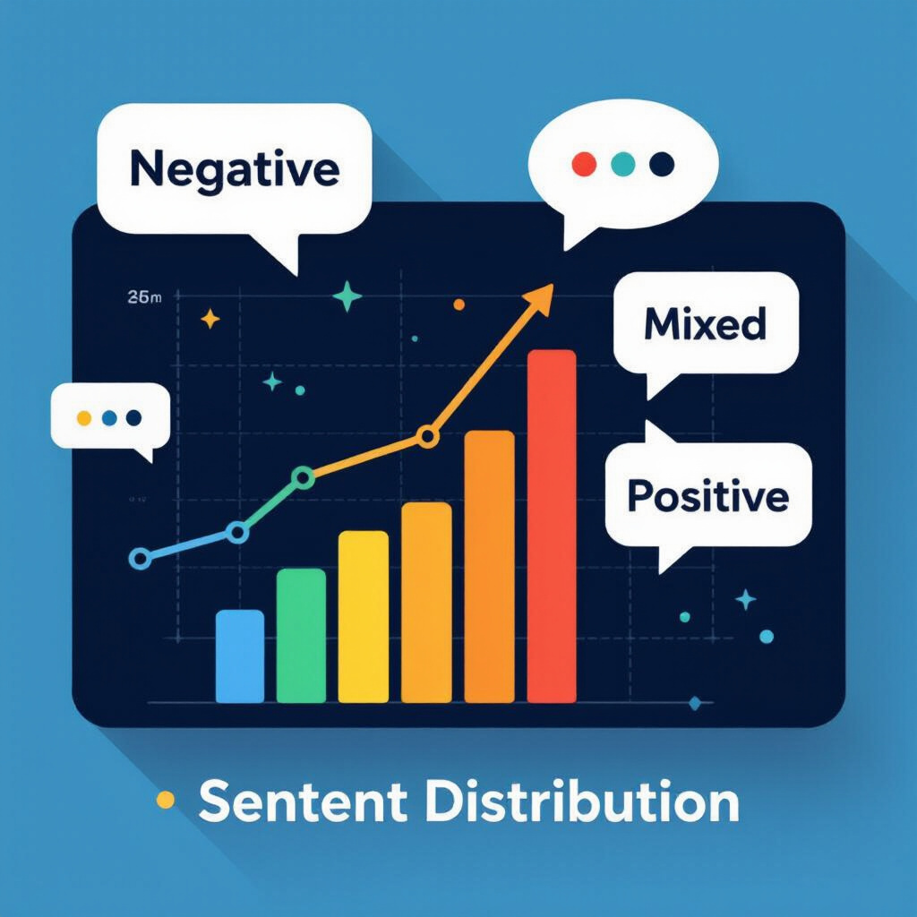

Data Visualization: Word Clouds
Word clouds are generated from word frequencies, offering visual insights into sentiment data. This method highlights:
Commonly used words in positive, negative, and neutral contexts.
The overall sentiment landscape at a glance.

Slide 8
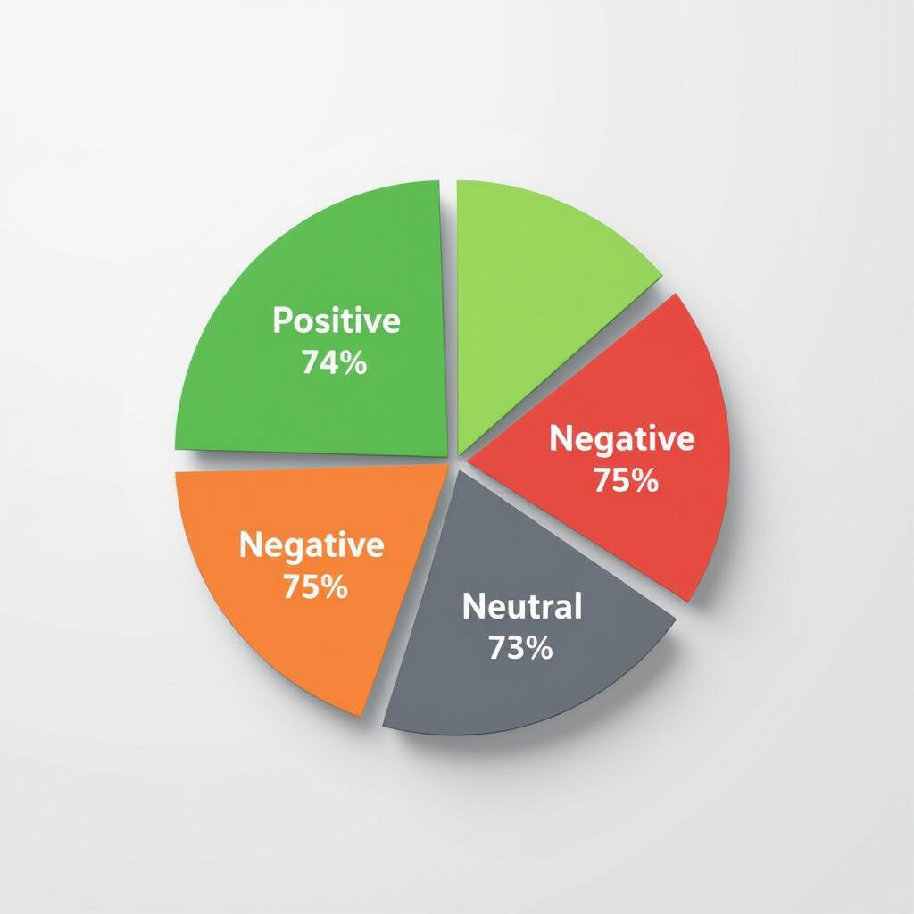
Data Visualization: Pie Charts
Pie charts are utilized to represent the distribution of sentiments:
Positive: Indicates favorable sentiment.
Negative: Reflects unfavorable sentiment.
Neutral: Shows content with no strong sentiment.

Slide 9
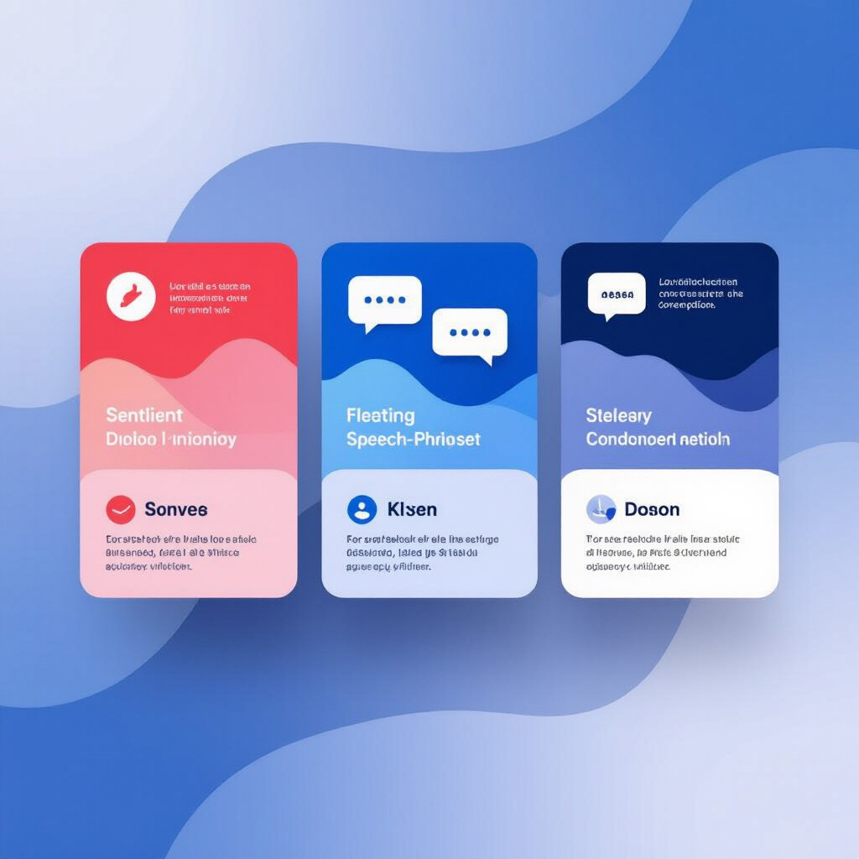
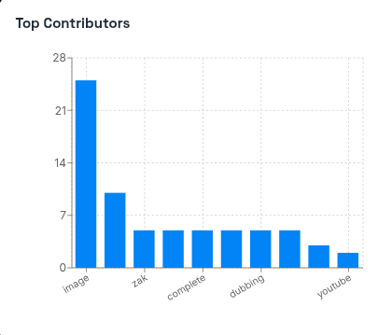
Data Presentation: Tables of Individual Posts
SentimentIQ presents tables displaying individual posts, which include:
Sentiment scores: Quantitative assessment of sentiment.
Top phrases: Key phrases associated with each post.
Summaries: Concise overviews for quick understanding.

Slide 10
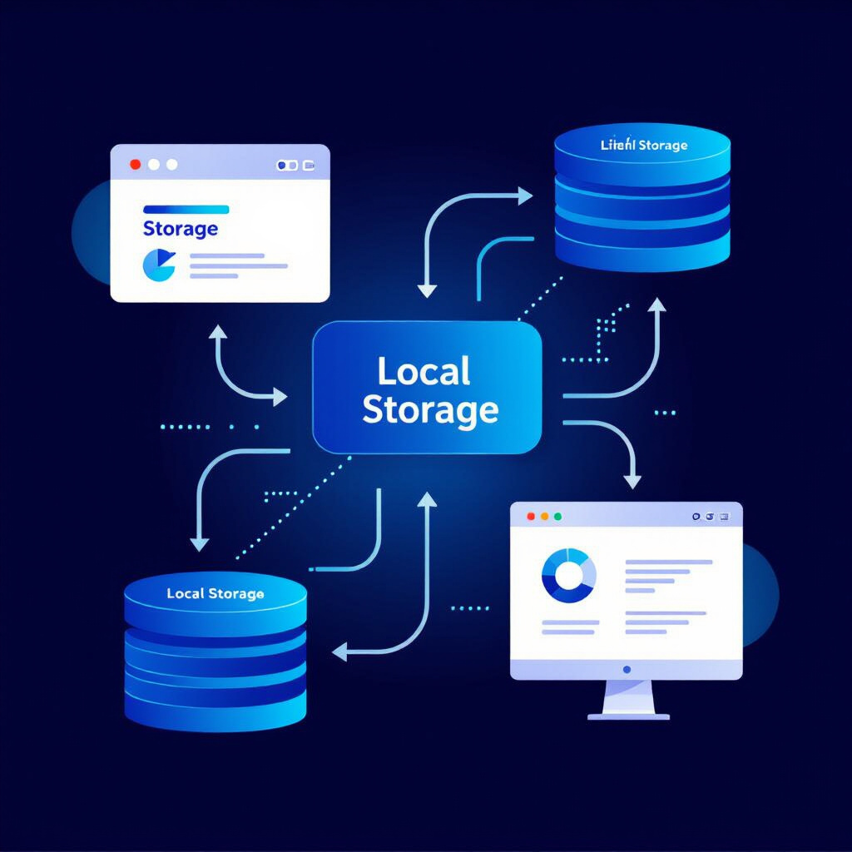
Local Storage for History Access
Users can store and access their analysis history through local storage. This feature allows for:
Convenient retrieval of past analyses.
Enhanced user experience by reducing repetitive tasks.

Slide 11
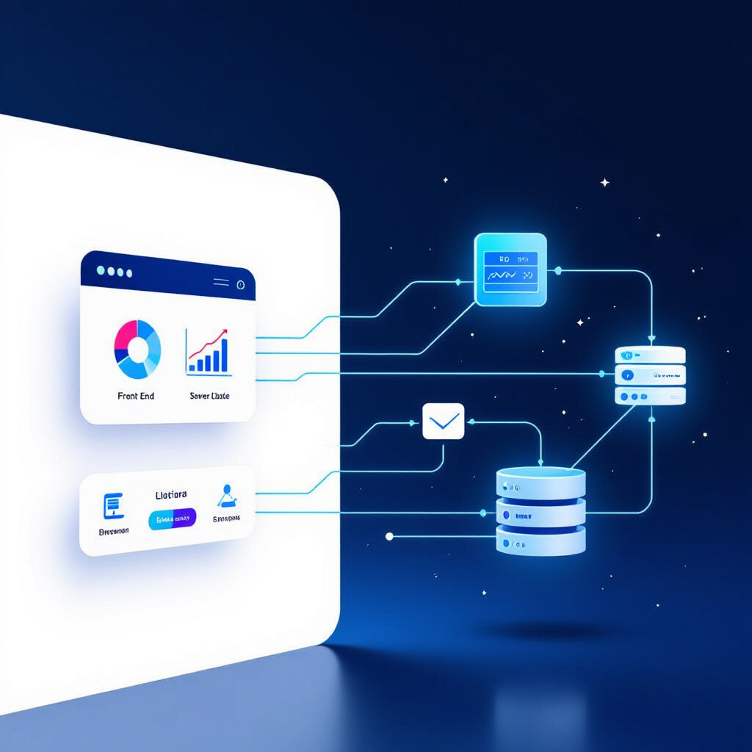
Data Flow Between Frontend and Backend
The data flow between the frontend and backend is crucial for seamless operation:
User inputs are sent to the backend for processing.
Processed data is returned to the frontend for visualization and interaction.
This interaction ensures real-time updates and responsiveness.

Slide 12
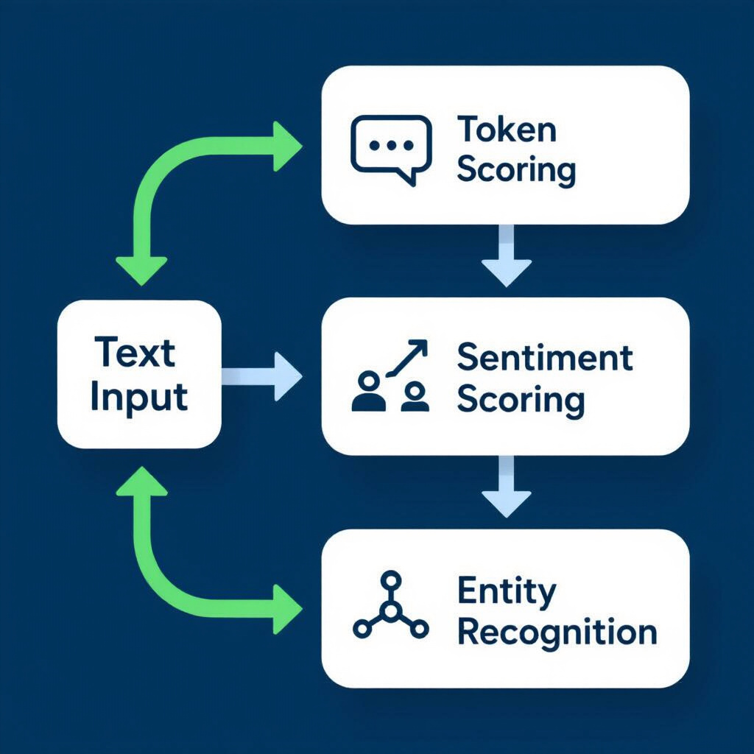
NLP Preprocessing Techniques
Natural Language Processing (NLP) preprocessing techniques are employed to prepare data for sentiment scoring:
Tokenization: Breaking text into individual words or phrases.
Stopword removal: Eliminating common words that do not contribute to sentiment.
Stemming and lemmatization: Reducing words to their base forms for accurate analysis.

Slide 13
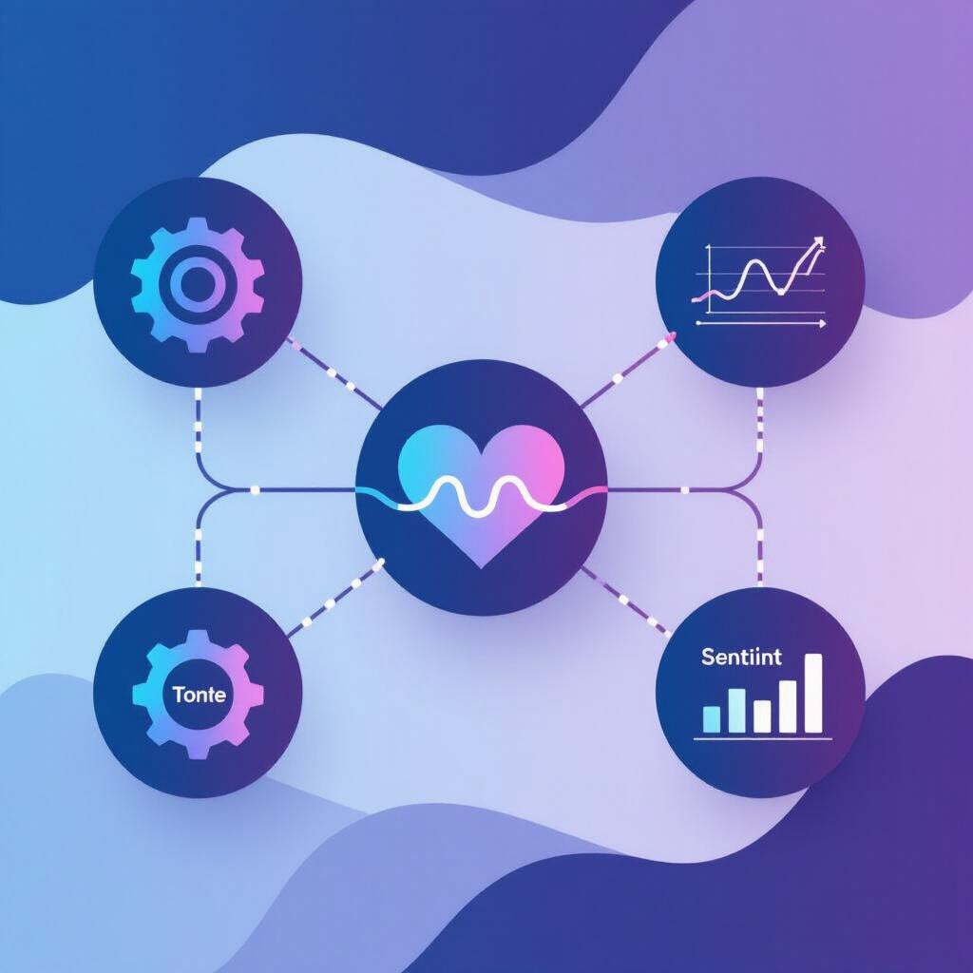
Sentiment Scoring Methodology
The sentiment scoring methodology involves:
Utilizing algorithms to assess sentiment based on predefined metrics.
Analyzing the context and emotional tone of the content.
Providing a comprehensive sentiment score for each piece of content.

Slide 14

Visualization Dashboards
SentimentIQ features visualization dashboards that present analysis results in an engaging manner. These dashboards inclu- de:
Interactive charts and graphs.
Real-time updates reflecting user inputs.
Comprehensive insights into sentiment trends.

Slide 15
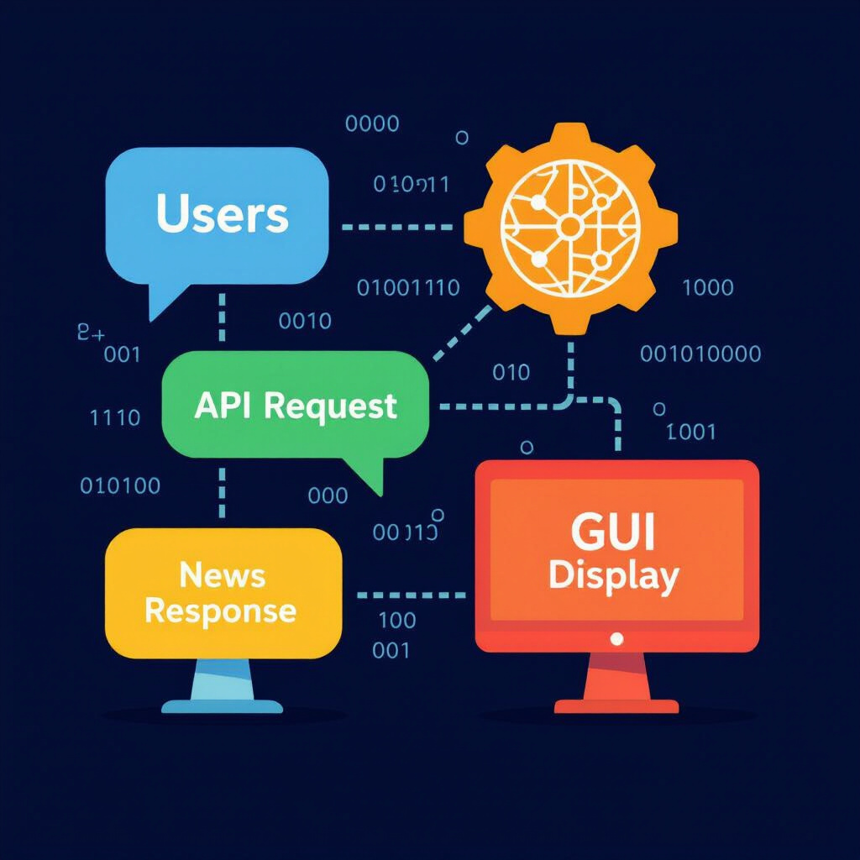
User Interaction Flow
The user interaction flow is designed for ease of use:
Users input URLs and initiate analysis.
Results are displayed through visualizations and tables.
Users can navigate through features seamlessly, enhancing their experience.

Slide 16

Conclusion: The Future of Sentiment Analysis
The future of sentiment analysis is promising, with platforms like SentimentIQ leading the way. As technology advances, the potential for deeper insights and more accurate sentiment assessments will grow, making sentiment analysis an invaluable tool in various fields.

